Slide 1

Globalization in Baseball
Data Analysis and Visualization - Project #1
February 11th, 2021
Javier Cuervo

Slide 2

Motivation & Summary
Baseball fan wanting to find out where MLB players originate from.
From what Countries? Cities? States? Where do the best players come from?
Use data analysis and data visualization techniques to clean, extract, analysis and present findings.
Summarize conclusions

Slide 3

Questions Asked
Question #1:
What does Globalization in MLB look like?
Question #2:
What Countries, Cities, and States produce the most MLB players?
Question #3:
Do players from certain Countries outperform others?

Slide 4

What does globalization in MLB look like?
Let’s dive in

Slide 5

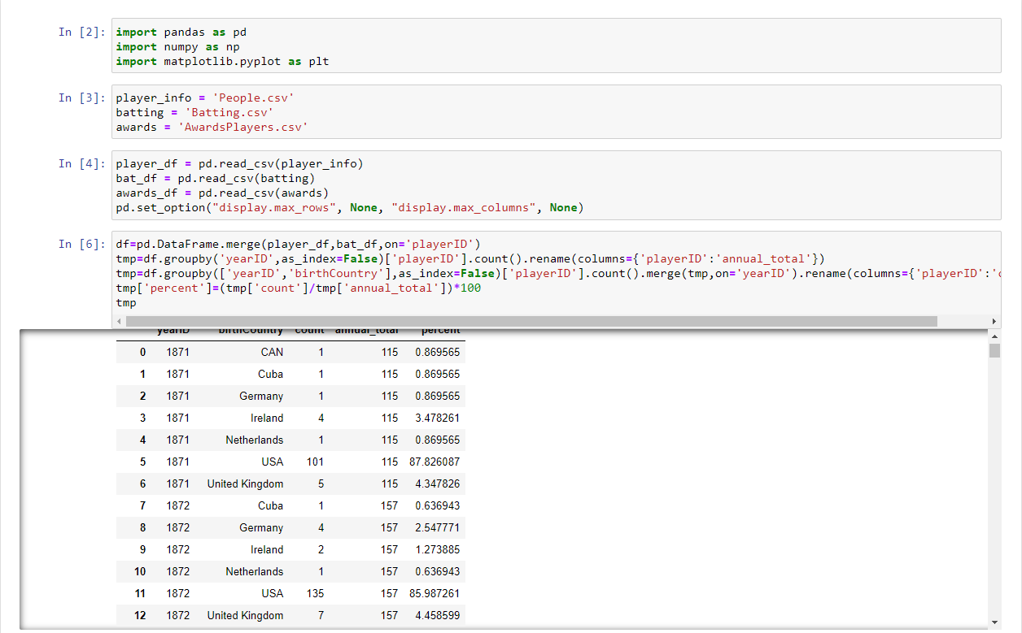
The Code
The data set that I used contains complete batting and pitching statistics from 1871 to 2020, plus player demographics, season-ending awards, managerial records, post-season data, and more.
http://www.seanlahman.com/baseball-archive/statistics/

Slide 6
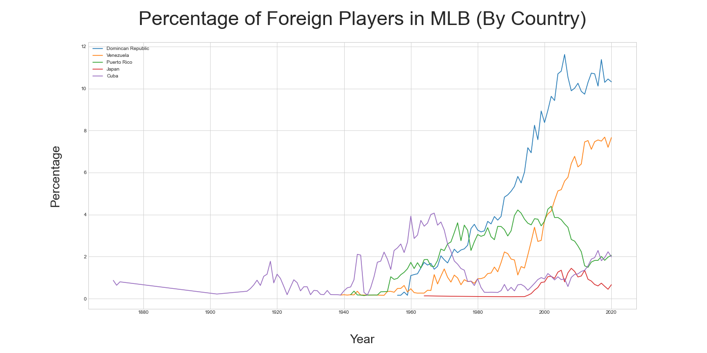

Slide 7
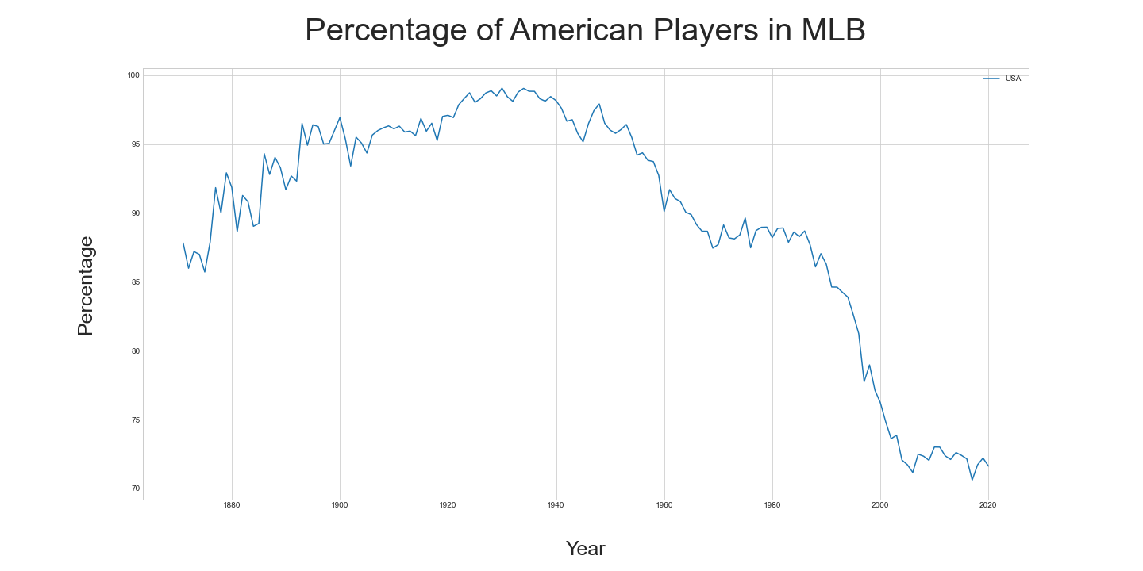

Slide 8
What Countries, Cities, and States produce the most MLB players?
Let’s dive in

Slide 9
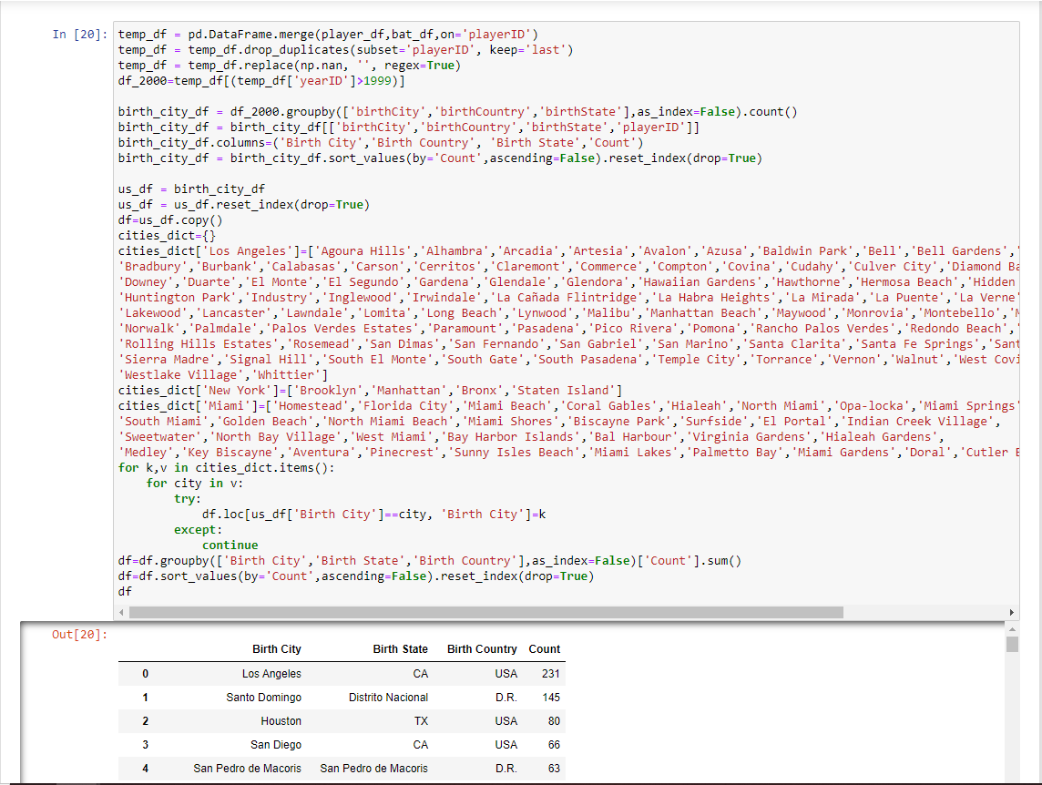
The Code

Slide 10
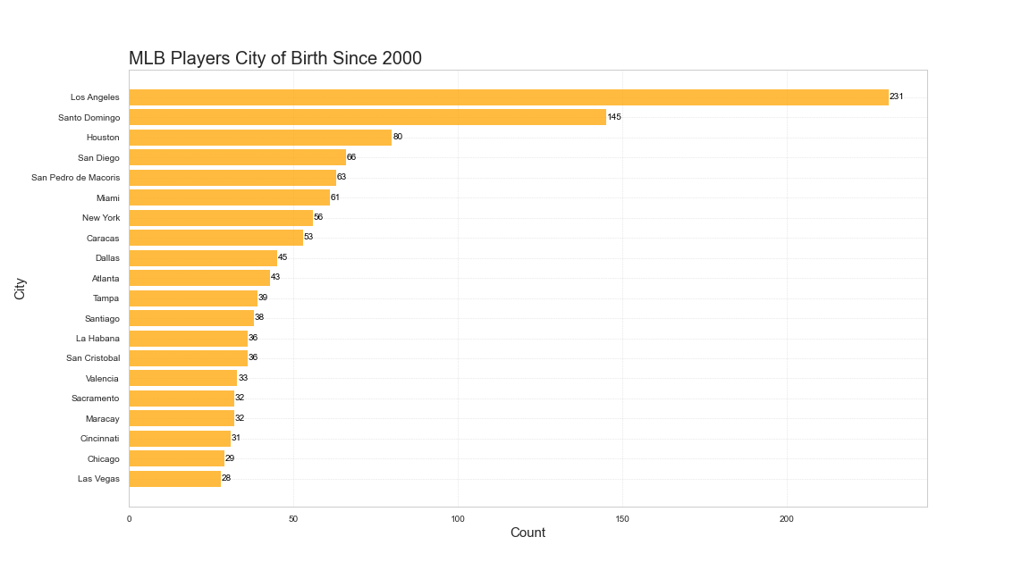

Slide 11

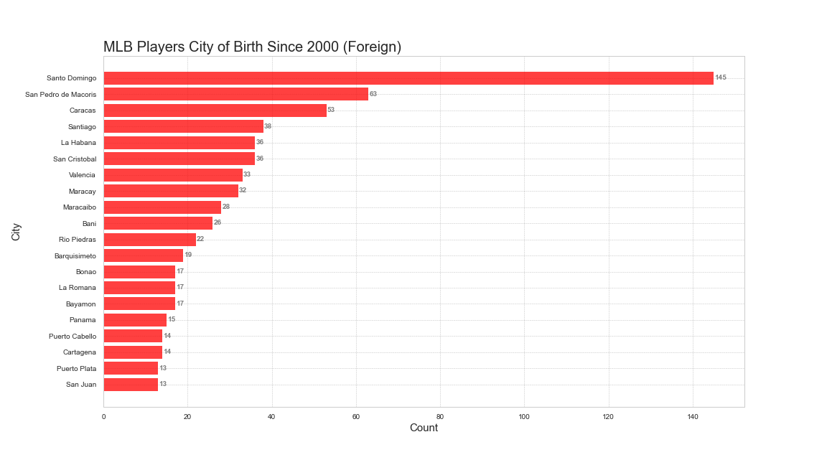
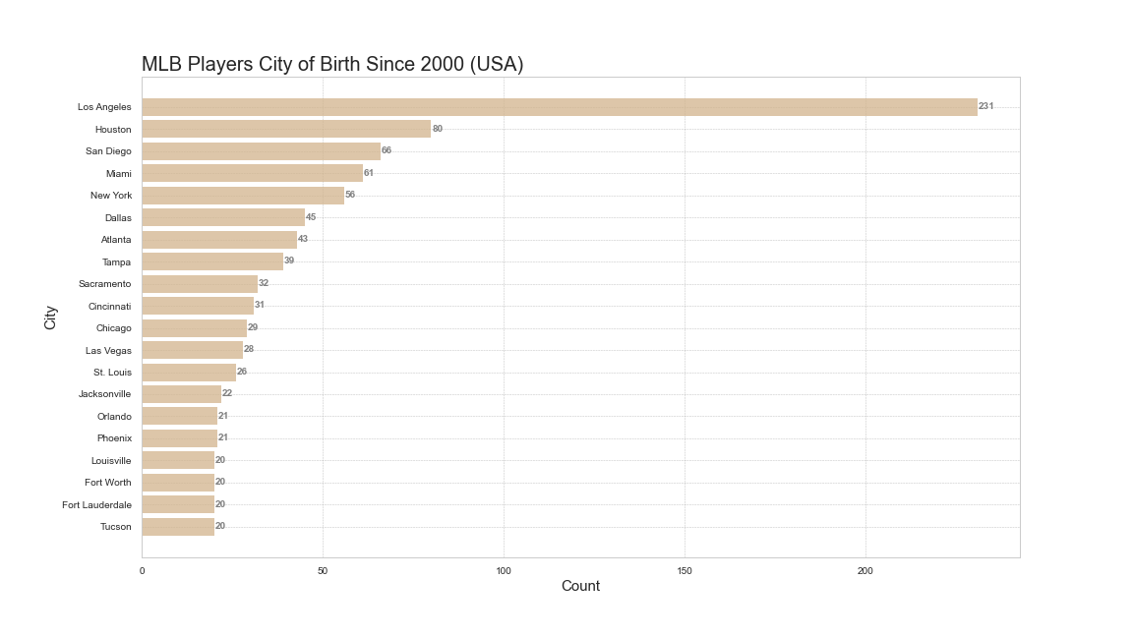

Slide 12
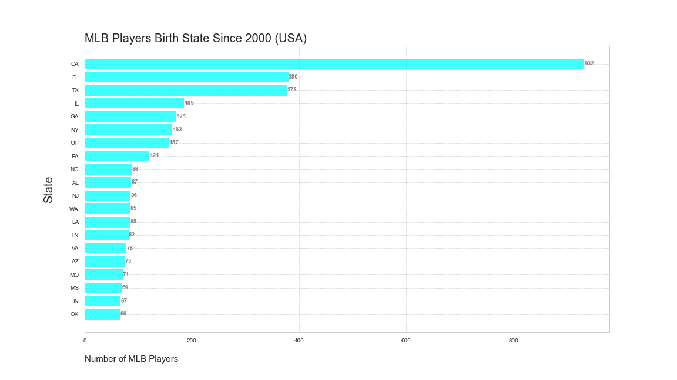

Slide 13
Do players from certain countries outperform others?
Let’s dive in

Slide 14
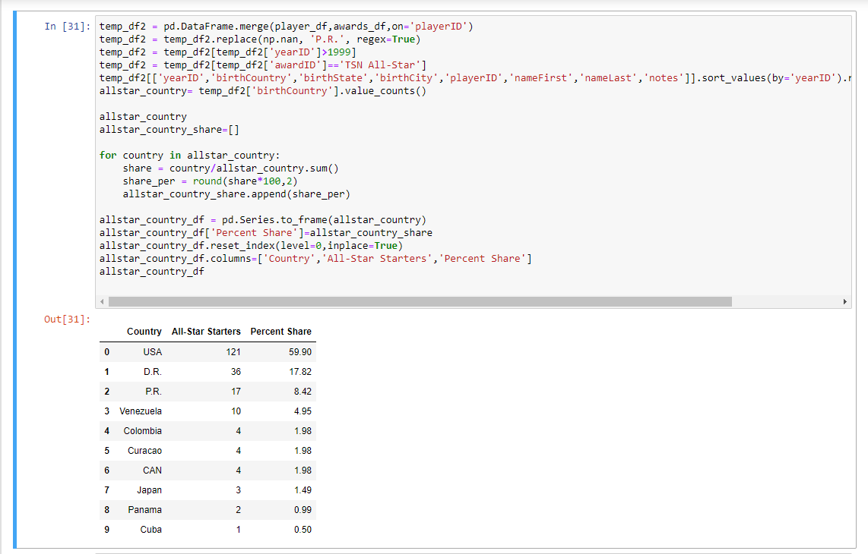
The Code

Slide 15
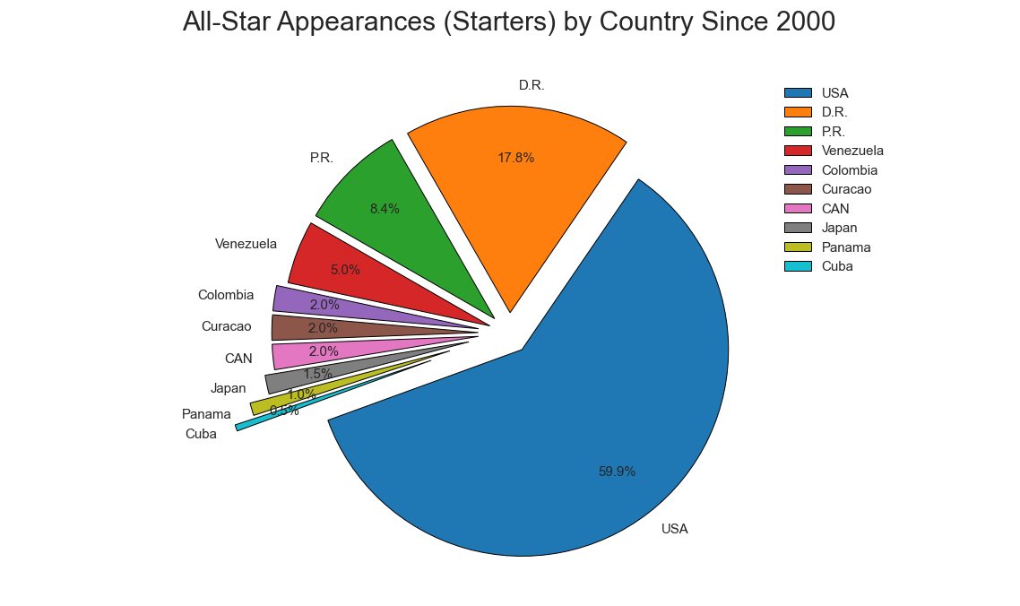

Slide 16
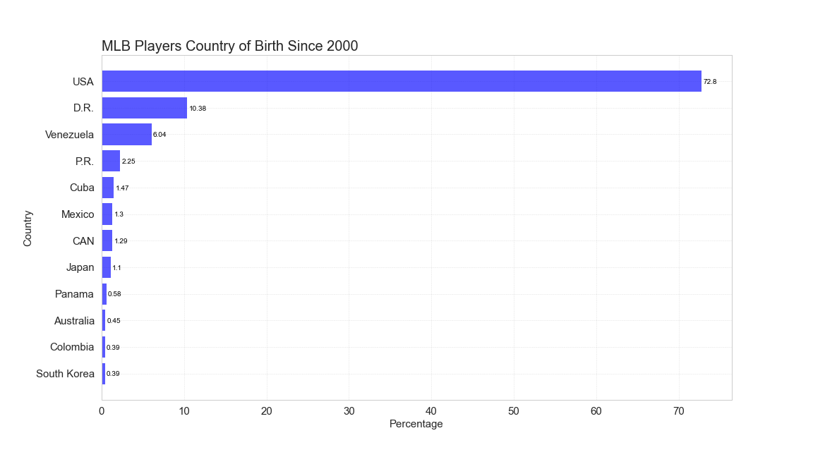

Slide 17
Conclusions
Major League Baseball is steadily becoming more global. The game continues expand in Caribbean, South American, and Asian nations.
Since 2000, the predominant cities for supplying MLB players are not limited to those just in the US.
As the game becomes more global, so do the best players in the game.

